Slide 1

System Design and Verification
Advanced Program construction
Lecturer: Wang Zhengyang
Xu Chuyuan
Wen Haotian
Xiao Yao
Wei Danling

Slide 2
Introduction
1.What we’ve learnt until now is not program.
2.We have just learnt two languages
and some Algorithm.

Slide 3
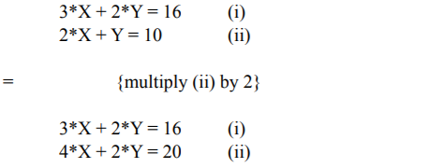


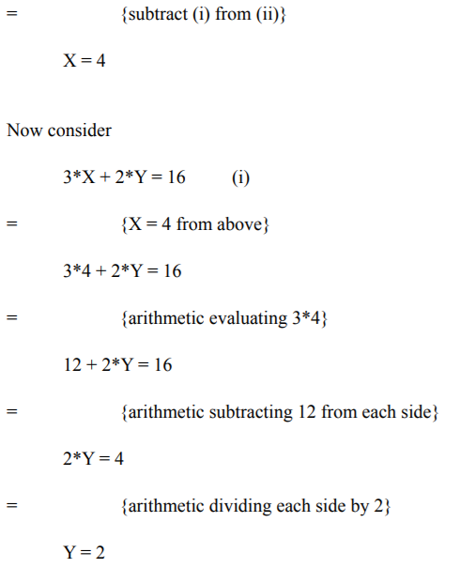
Simplification and Analysis
16
10
Cost ?

Slide 4
System Design and Verification
① Specification
② Tools
③ Theorem
Notation
Calculational Programming
The Reduction Theorem
The Linear Search Theorem
…
…

Slide 5
Advanced Program Construction
For solving more complex problems and further study
……………

Slide 6
Summary
1.We should distinguish programming task and Programming.
2.We are supposed to avoid writing program
instead of concentrating on how to program
3.We should change our attitude

Slide 7
Thank you for listening

